Slide 1


CURRENCY CONVERTER
(Using python language)
By : Sachin Pandey ,Amanjot Kaur and jashanpreet Kaur

Slide 2
Outlines:
Introduction
Alogorithm
Flowchart
Coding
Conclusion

Slide 3

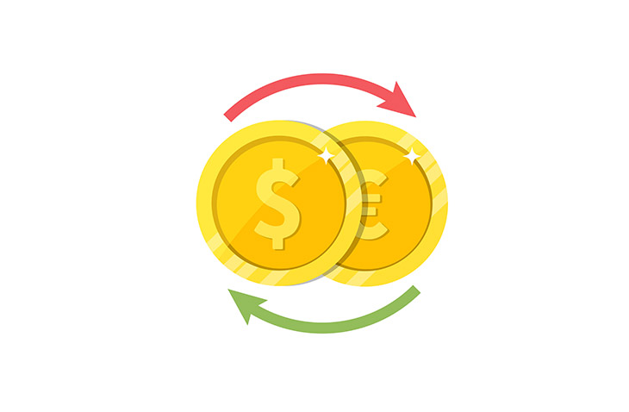
Introduction
Currency converter is the tool used to change one country’s currency to another .
In this project we created a currency convertor using Python language.
In our project you can convert any available currency in our project to The Indian rupee (INR).

Slide 4
Algorithm
Step 1: Enter the choice of the currency to convert to INR.
Step 2: Enter the amount you want to covert to INR .
Step 3: Now run the program from the ‘RUN’ button .
Step 4: The result will display .
Step 5: To convert any other currency click ‘RUN’ botton again.

Slide 5
Flowchart:
Start
Enter the choice to convert
If currency available
Else currency does not exist
Run the program
Enter the amount
Stop
Result

Slide 6
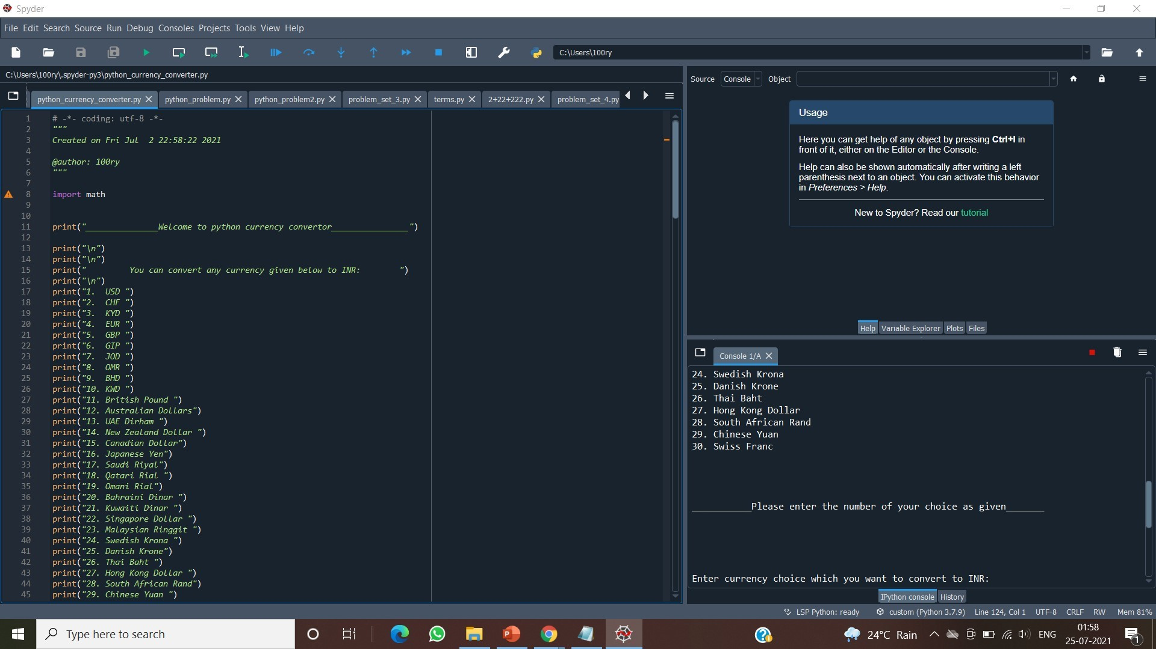
Coding
We have used python language for programming .

Slide 7
Conclusion
In this project we developed a currency convertor in python language to know currency values in our currency .
In our project you will find choice of currency to convert but if currency is not exist in our program it will show a message.
We can develop it futher by adding some more currencies as well as their values .

